Slide 1

Competitive Analysis: Parch and Posey Sales Data Insights
By Keletso Ntseno

Slide 2
Executive Summary
Overview of Parch and Posey's business operations
Key findings from the database analysis
Strategic recommendations based on insights

Slide 3
Database Schema Overview
Parch and Posey database tables
accounts
orders
sales_reps
regions
Relationships between tables
Key metrics available for analysis

Slide 4
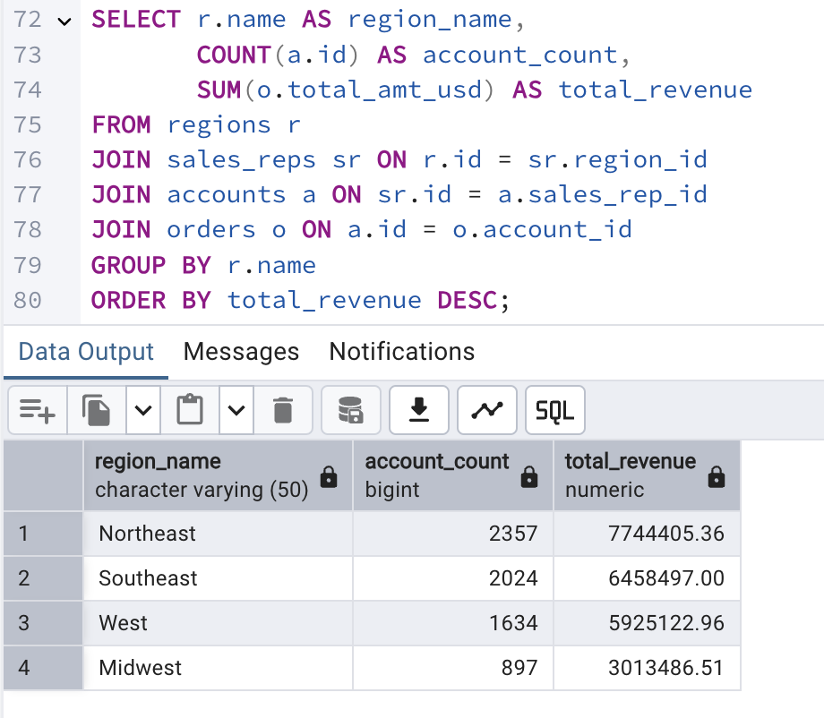
Regional Performance Analysis
Total revenue per region
Number of accounts per region
Top-performing regions highlighted

Slide 5
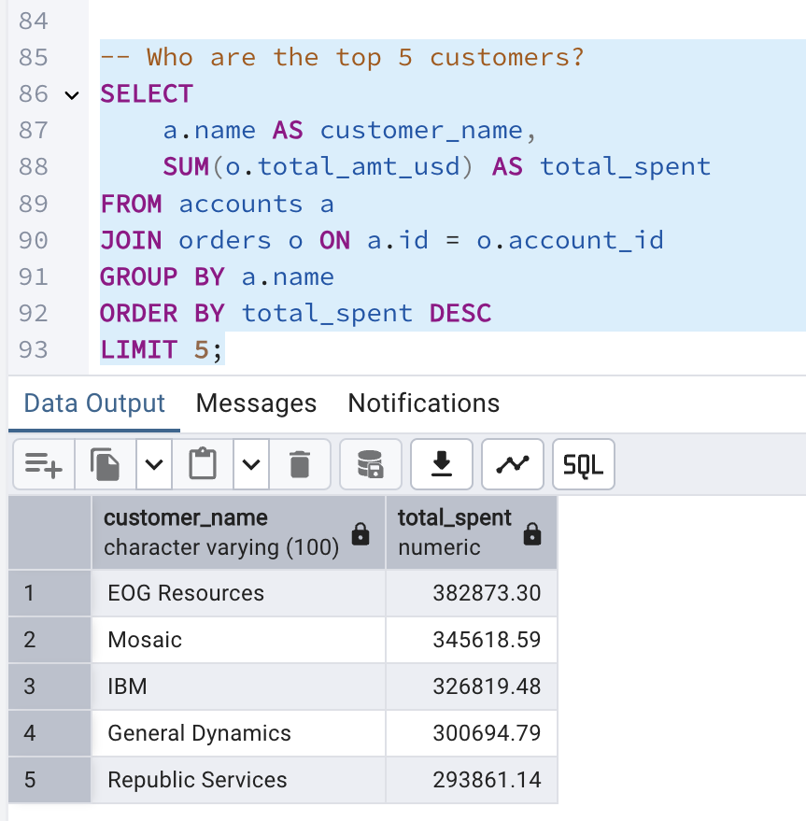
Top 5 Customers by Revenue
The insights of this query Identifies the most valuable customers.

Slide 6
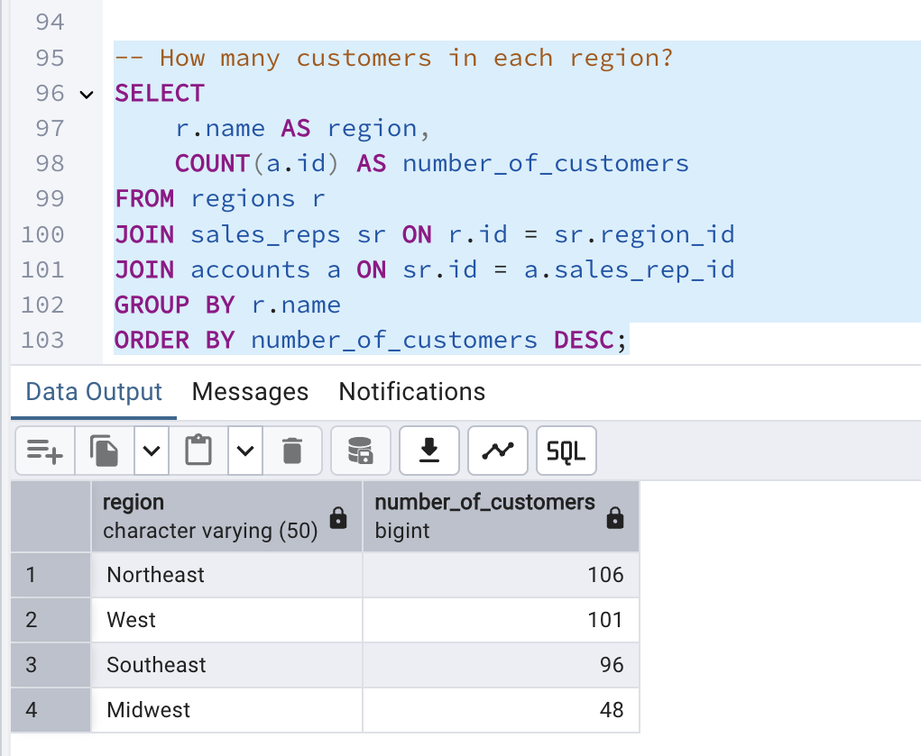
Number of Customers per Region
The insights of this query show which regions have the most customers.

Slide 7
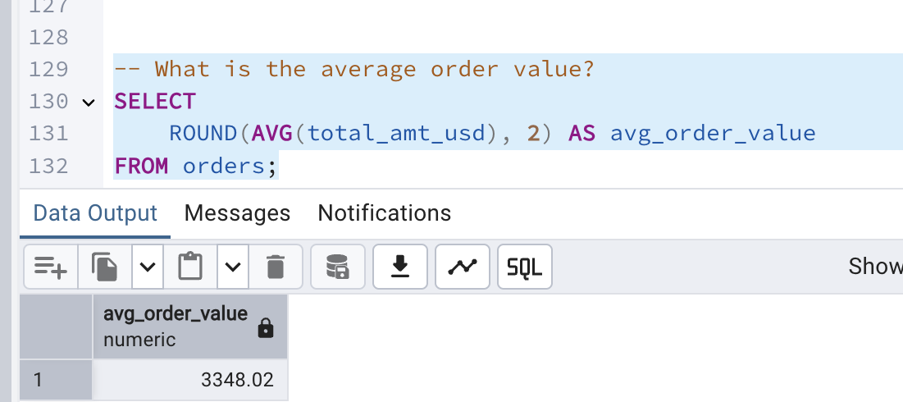
Average Order Value
This query will assist in understanding the typical transaction size.

Slide 8
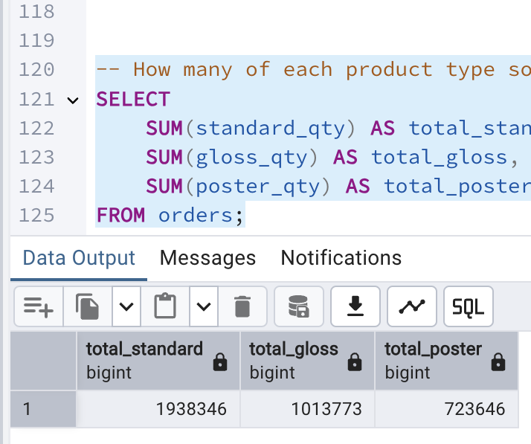
Total Quantity Sold by Product Type
Shows which products are most popular.

Slide 9
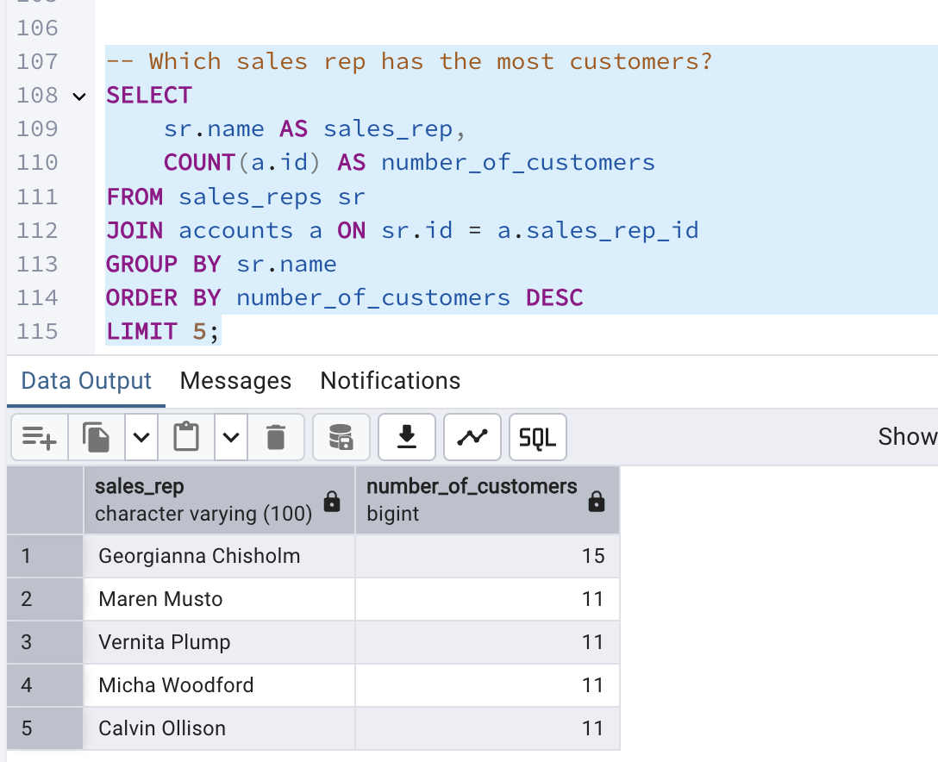
Top Sales Rep by Number of Customers
Highlights the most active sales reps.

Slide 10
Key metrics available for analysis
This analysis of Parch and Posey's data focuses on five key metric categories: sales performance (revenue, order volume, average order value).
customer analytics (account distribution, regional penetration, sales rep effectiveness), product performance (revenue contribution across product lines).
temporal trends (seasonality and growth patterns), and geographic performance (regional revenue distribution).
These metrics collectively reveal their operational strengths, market position, and potential growth opportunities.

